Slide 1

An Introduction
Dr Simon Lock
simon.lock@bristol.ac.uk

Slide 2
What is Open Project ?
An online open-source project management tool
Fairly basic set of functionality
Provides all you need to plan and track projects
We have it installed on our development server
Currently under “active development”
However stable enough to be used for SPE

Slide 3
Why are we using it ?
To help you plan your project work
To provide an implicit communication tool
To help you keep track of your team’s progress
To teach you a bit about project management
To allow Dan and I to keep track of progress
To provide transparency to aid marking process
(what was your process like ? who did what ?)

Slide 4
Open Project Setup
You can access Open Project at this URL:
https://test.openproject.spe-hub.net
Each team will have a project created for them
You will be sent an invite to join OP
You should already be added to your project !

Slide 5
“Getting started” within OP
Fill out project description
Create work packages (Phase/Task/Milestone)
Estimate effort required (in hours)
Schedule work packages (start and end dates)
Create an activity timeline
Add work package dependencies
Allocate team members to work packages
Create a Git repository & link it to you OP project

Slide 6
Work Packages
A project in OP is based around “work packages”
Many different types, but we recommend:
Phase: Stage of project (e.g. domain investigation, initial design, MVP, release iteration, evaluation)
Task: Bundle of dev work (e.g. “write config file reader”, “test wireframes”, “create timeline”)
Feature: Atomic fragment of functionality (e.g. “add user function”, “backup database script”)
Milestone: Key waypoint in development (e.g. frontend and DB connected, app runs on phone)

Slide 7
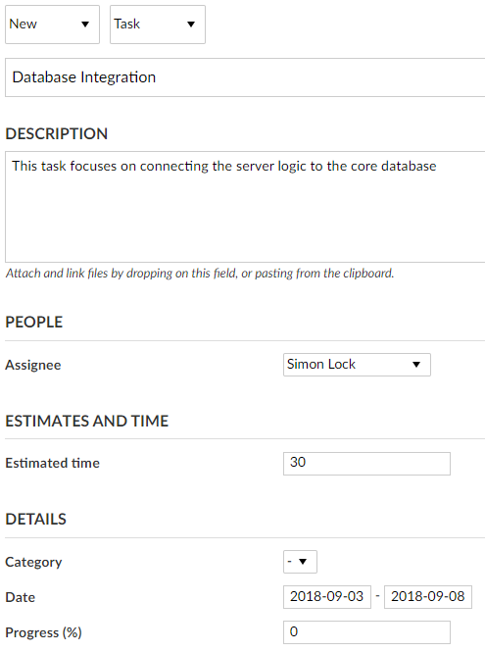

Slide 8
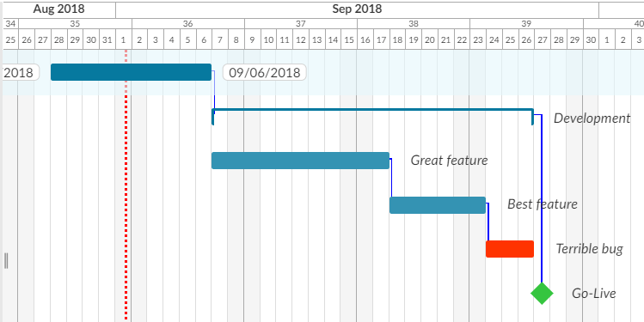
Activity Timeline (Gantt chart)

Slide 9
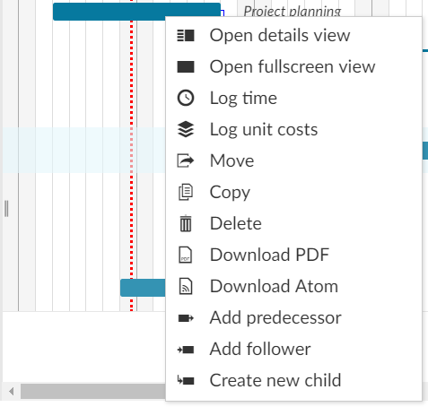
Adding dependency relationships

Slide 10
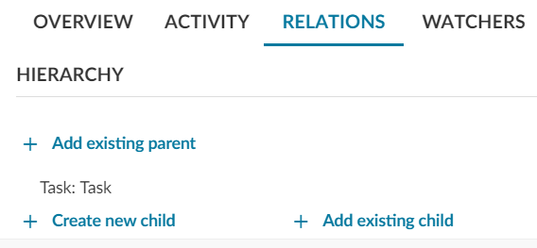
Adding parent/child relationships

Slide 11
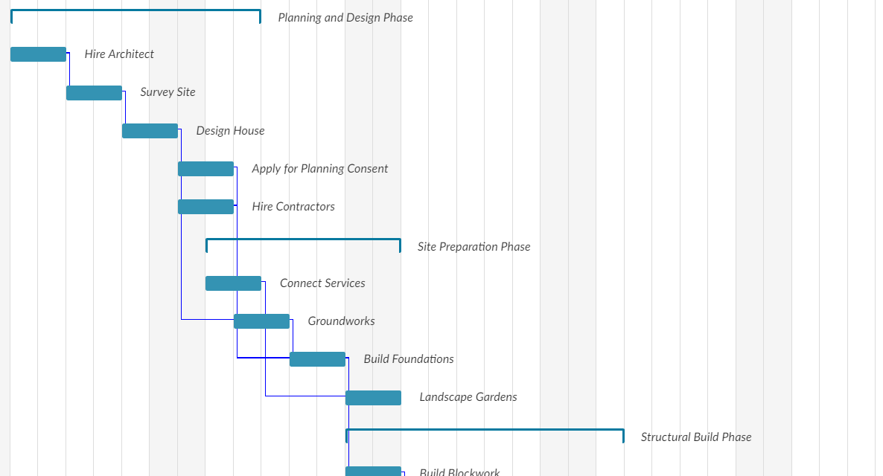
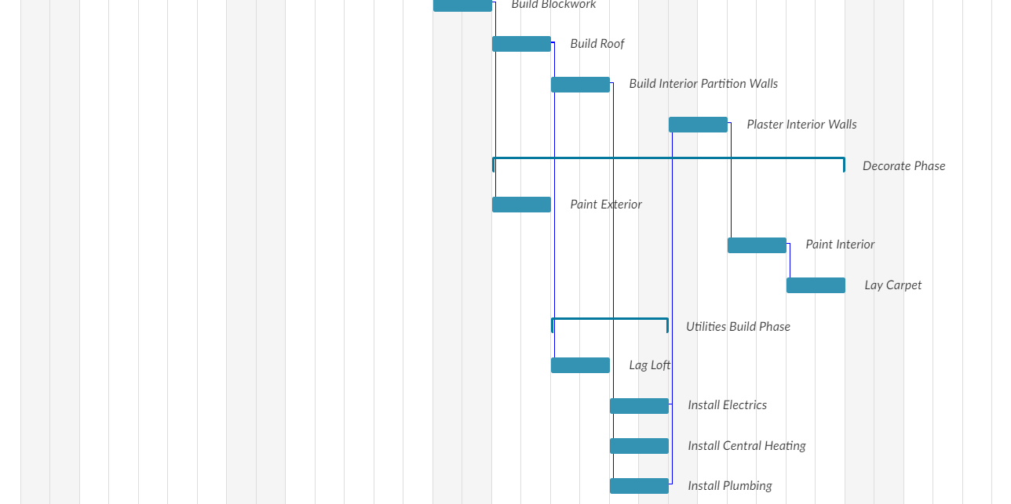
Building your own house

Slide 13
Timeline Caution !
Be careful when viewing the project timeline…
It’s really easy to accidently drag activities around
It’s wise to screenshot your timeline occasionally
(in case you mess it up, or something goes wrong)

Slide 14
Recording Meetings
You should record all meetings (both internal group meetings and external client meetings).
Be sure to capture the following information:
Invitees – Who was supposed to attend meeting (from the development team)
Attendees – Who did actually attend the meeting
Agenda – A very brief overview of what the meeting is intended to be about
Minutes – Any major decisions or actions arising from the meeting (a bullet-point list is fine !)

Slide 15
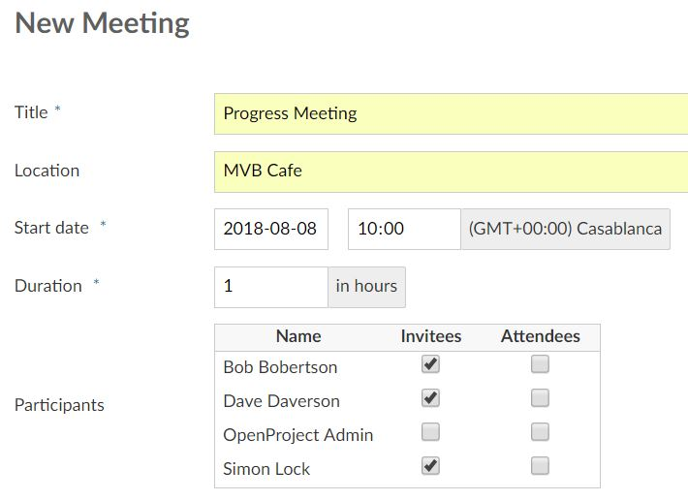

Slide 16
Work Repository
Outputs (code & docs) must be version controlled
This will support sharing and group collaboration
Dan and I will also be able to track progress !
Documents should be written in “Mark Down”
Use a different file for each section of the doc
This will help collaboration and change tracking
Your chosen repo must support GIT or Subversion
This allows it to be registered within OP…

Slide 17
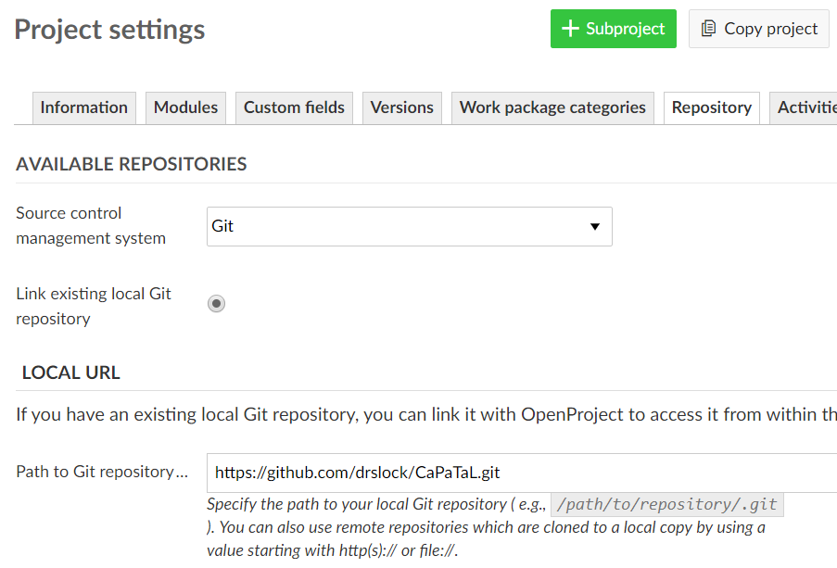
Git for public repos
Subversion for private

Slide 18
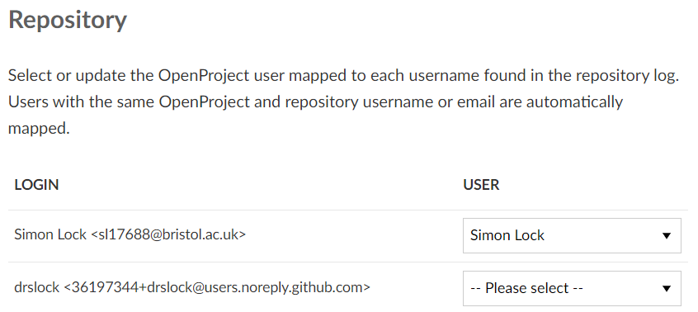

Slide 19
Change
We don’t expect you to predict it all in week 1
We do however expect you to update things in OP when they do become apparent
Whole team should agree on significant changes
Don’t just go in and hike up your effort hours !

Slide 20
Essential data to continuously update
WPs (how long they take, who is doing them)
Meetings (their purpose and who attends them)
Progress (percentage task completeness)
Status (“New”, “In Progress”, “Closed” etc.)
Releases (which WPs delivered in each release)
Documents (everything hosted on Git)

Slide 21
Things not to worry too much about
Costings and Budgets (there is no money anyway)
Don’t feel you need to use all work package types

Slide 22
The BIG payoff ?

Slide 23
Monitoring
OP provides us with PROJECT TRANSPARENCY
We can see WHAT you are up to and WHEN
This has a number of “benefits”…
We can monitor the patterns and flow of work
We can spot problems early on
We can “encourage” when work is falling behind
We can tell if people aren’t pulling their weight
We can mark teams on process, as well as product

Slide 24
Specific things we will be looking for
Detailed and realistic project plans
Team and Individual engagement with OP
Individual contribution to work packages
Individual attendance at project meetings
Keeping to due-dates, milestones and deadlines

Slide 25
Warning: Capture Data !
You MUST use open-project to its full potential…
If there is work to be done, it must appear as a work package (with a realistic estimate of hours)
If you are doing that work, you must be recorded as the assignee
When work is progressing, you must update the progress % and status (so we can see !)
If there is a meeting, it must be entered
If someone missed a meeting, it must be recorded

Slide 26
Individual Assessment
Recording information accurately is essential so that we can keep track of progress and identify “under engagement”.
When we come to mark the projects at the end of the year, these issues will impact the individual grades students will be awarded.

Slide 27
This is not a normal unit !
You can’t just attend passively
Then work hard on assignment/exam at the end
You need to proactivity engage and DO stuff
Throughout the whole of the unit
Fight for work – grab hold of tasks you excel at
This may be an familiar behaviour for some
Which is why we have introduced a prompt…

Slide 28
Tracking your own progress
It can be hard to grasp how well you are doing
Have to compare your contribution against others
Difficult to do without an overview of all work
This is where monitoring data comes in !
We will provide weekly analytics reports to mentors
Teams will discuss these in mentoring sessions
Derive ratings for each individual’s contribution
These will be recorded in OP as your “hourly rate”
This allows you to compare yourself with all others !

